Slide 1
Computer Network Laboratory (using Cisco Packet Tracer) Experiment-7

Slide 2
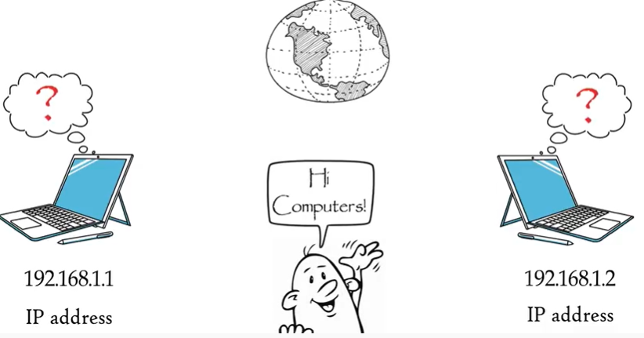
DNS (Domain Name System)
Computers always identify each other with unique numbers
called IP addresses as they do not
understand human languages.

Slide 3
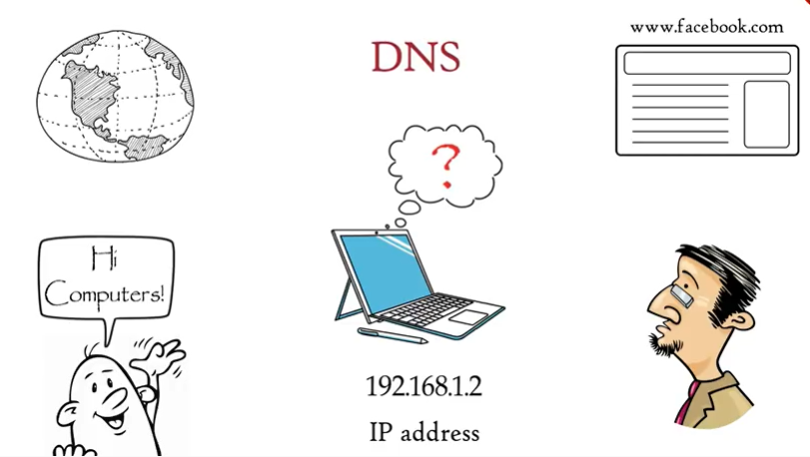
DNS (Domain Name System)
If computers do not understand human languages how they load a website when we type its address in the web browser's URL bar that's the place where DNS comes in.
DNS acts as a translator between humans and
computers

Slide 4
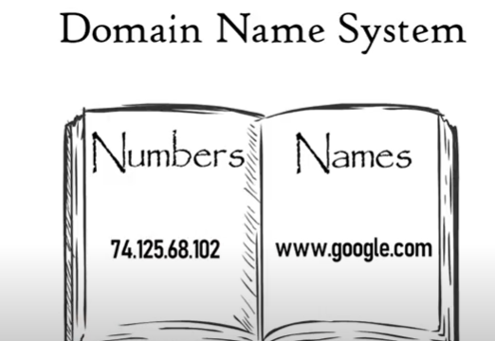
DNS (Domain Name System)
DNS or domain name system
maintains a table where names are mapped into numbers or more specifically where websites domain names are mapped to their IP addresses.
Now when we type google.com in the web browser DNS translates it to the web browsers language that is IP address and gives it to the web browser
Now web browser understands that we want to access Google. com so it contacts the Google server and loads google.com on the computer ensure DNS acts as a phone book of the Internet via computer

Slide 5
Configuration of DNS using packet tracer
Create single network
Required components
2 end devices , 1 Server
1 switch (2960)

Slide 6
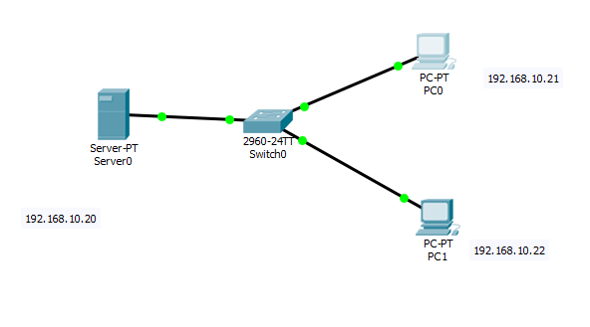
Place the devices

Slide 7
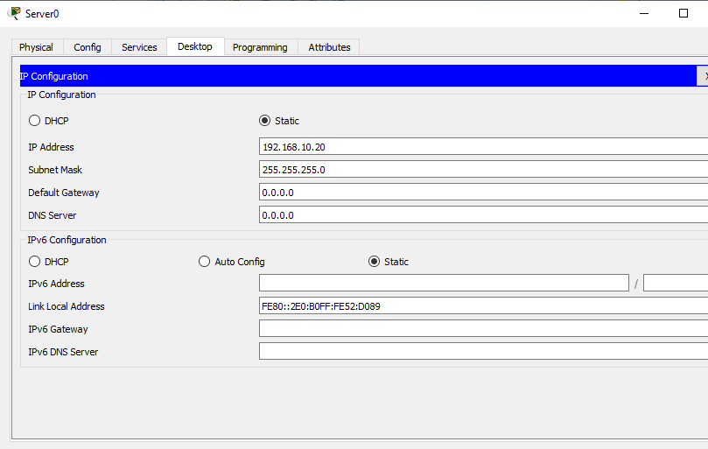
Steps
Assign IP to sever and level it

Slide 8
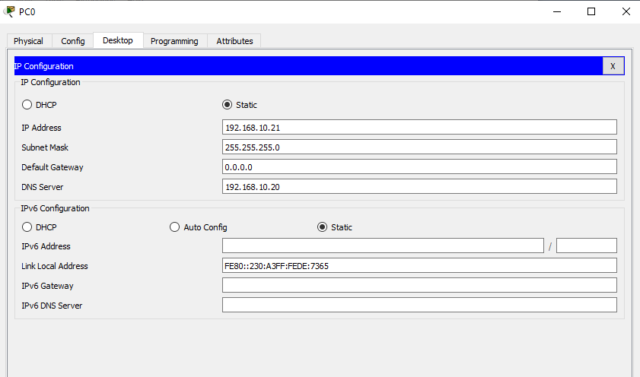
Steps
Assign IP to all the pc and level it

Slide 9
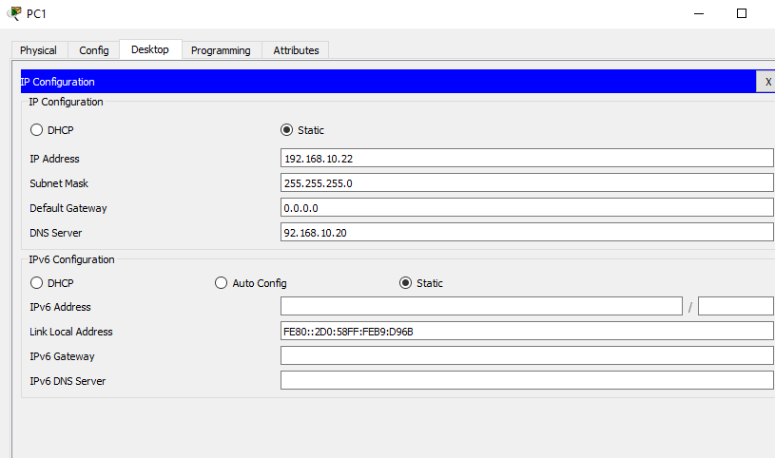
Steps
Assign IP to all the pc and level it

Slide 10
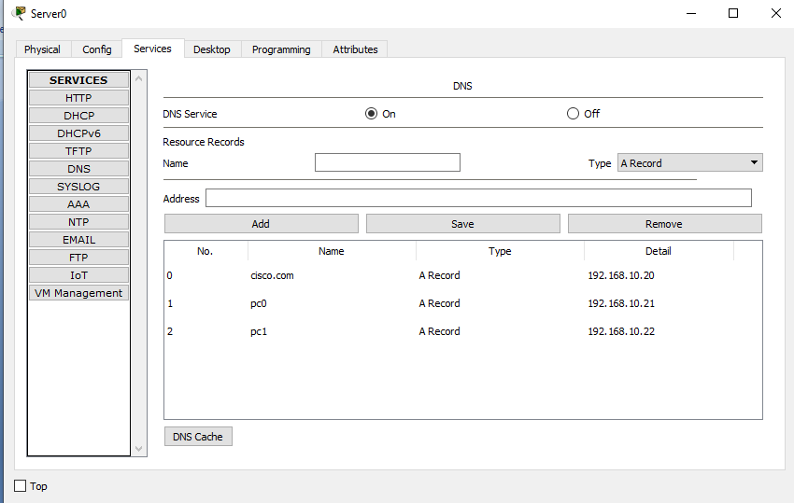
Steps

Slide 11
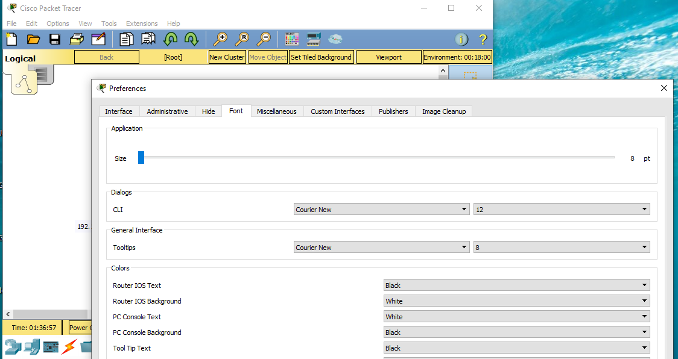
Steps
To increase the font size,

Slide 12
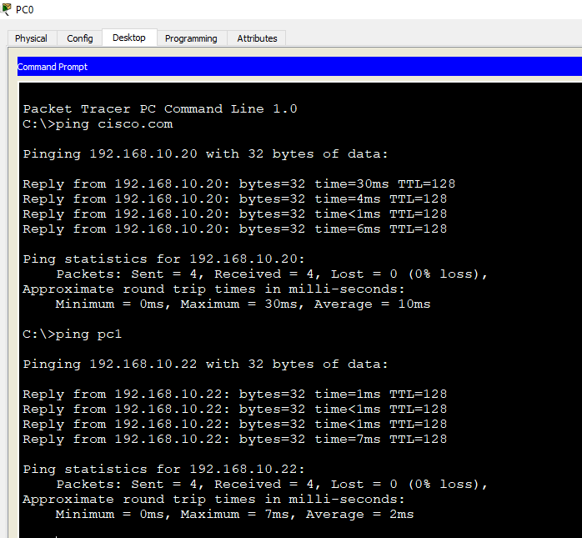
Output

Slide 13
Computer Network Laboratory (using Cisco Packet Tracer) Experiment-8

Slide 14
Configure WebServer
Web Server: Web server is a program which processes the network requests of the users and serves them with files that create web pages. This exchange takes place using Hypertext Transfer Protocol (HTTP).
Basically, web servers are computers used to store HTTP files which makes a website and when a client requests a certain website, it delivers the requested website to the client.
For example, you want to open Facebook on your laptop and enter the URL in the search bar of google.
Now, the laptop will send an HTTP request to view the facebook webpage to another computer known as the webserver. This computer (webserver) contains all the files (usually in HTTP format) which make up the website like text, images, gif files, etc.
After processing the request, the webserver will send the requested website-related files to your computer and then you can reach the website.

Slide 15
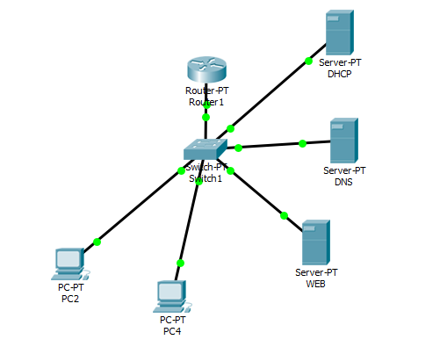
Configuration of Web server using packet tracer
Create single network
Required components
2 end devices , 3 Server
1 switch (switch PT)
1 router (Router PT)

Slide 16
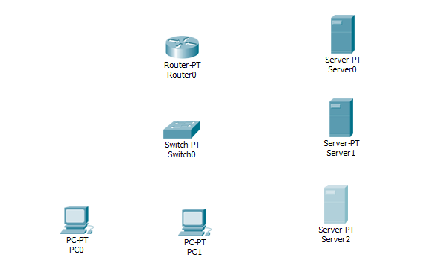
Place the devices

Slide 17
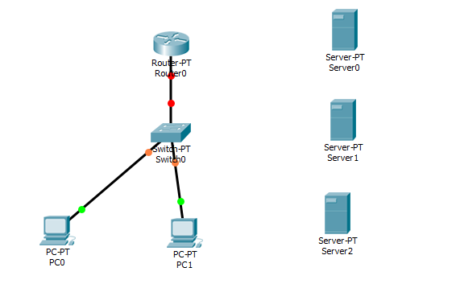
Connect the devices

Slide 18
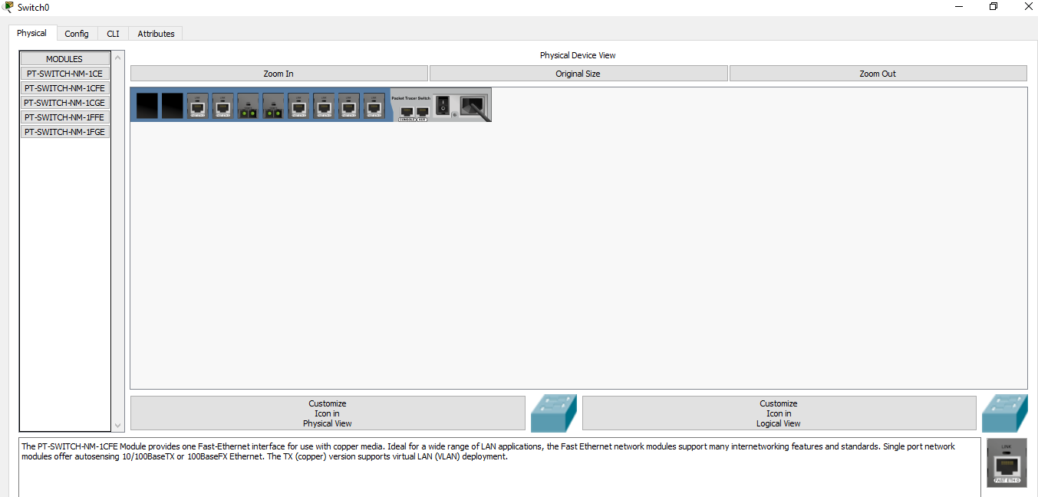
Add port to the switch
First switch off the SWITCH
Add ports
Switch on the devices

Slide 19
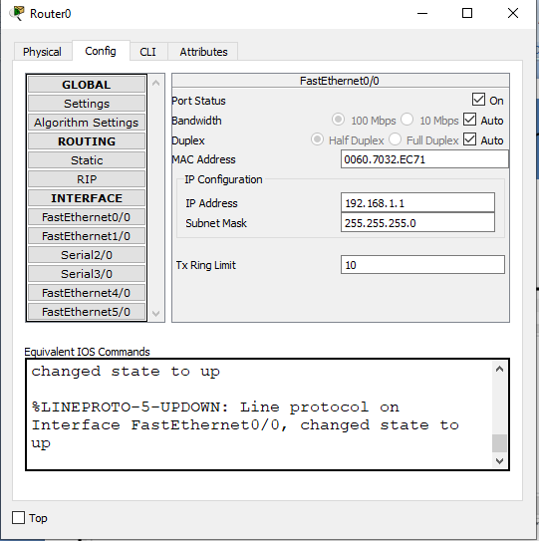
Configure Router

Slide 20
Modified Connection

Slide 21
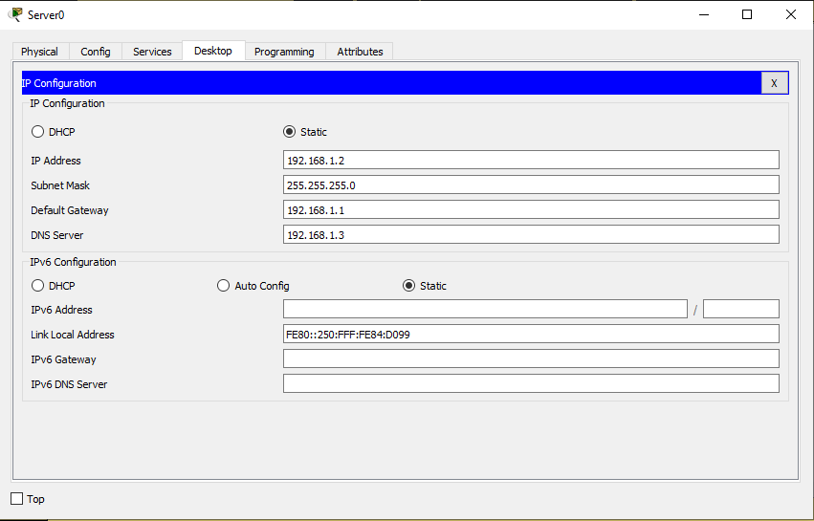
Add IP to DHCP server

Slide 22
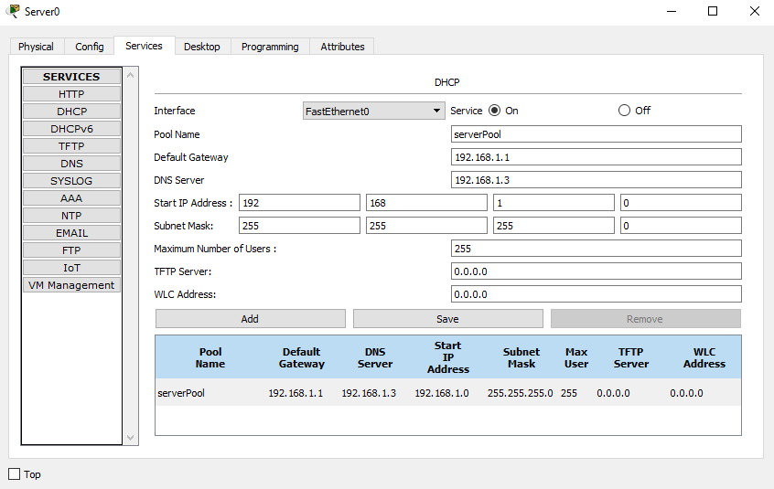
Add IP to DHCP server

Slide 23
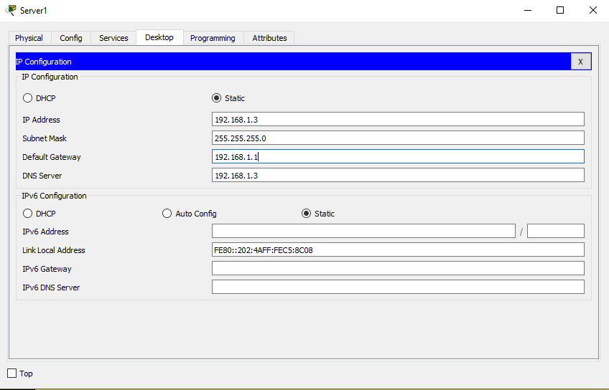
Add IP to DNS server

Slide 24
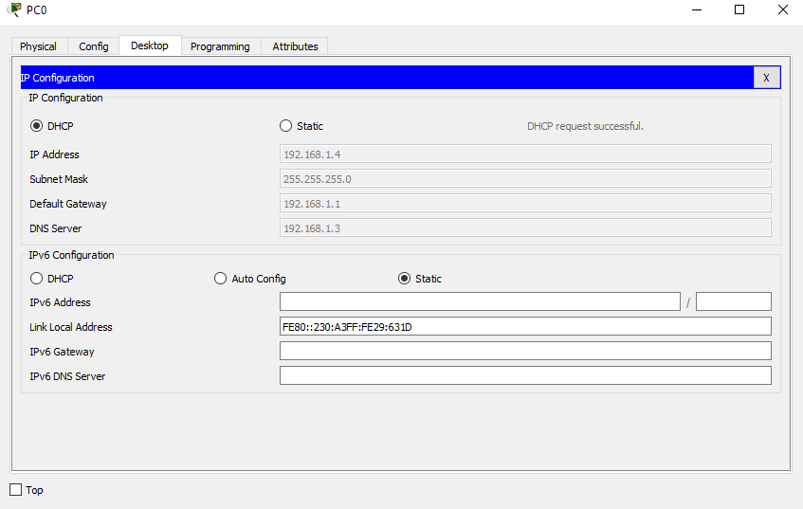
Steps Go to PC0→ Destop→Select DHCP Automatically IPs will be assigned

Slide 25
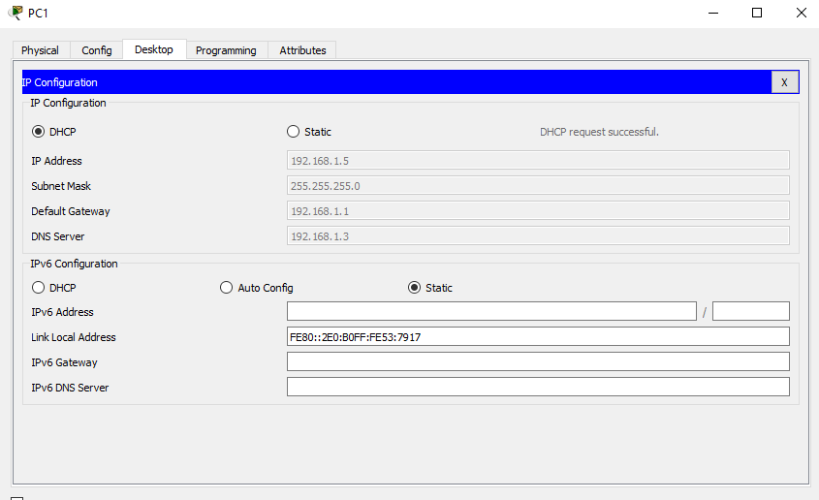
Steps Go to PC1→ Destop→Select DHCP Automatically IP will be assigned

Slide 26
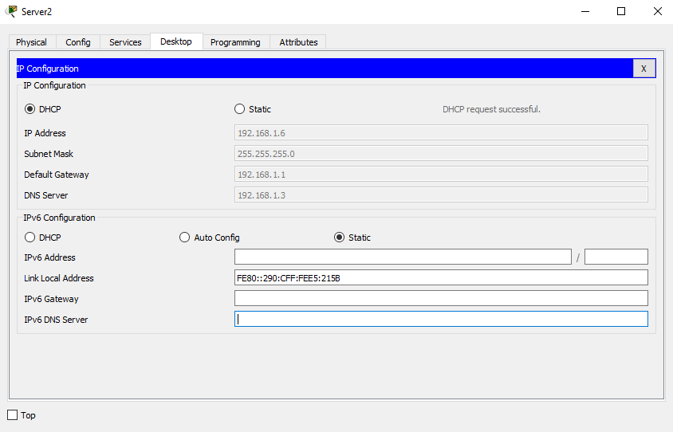
Using DHCP assign the IP to the web server

Slide 27
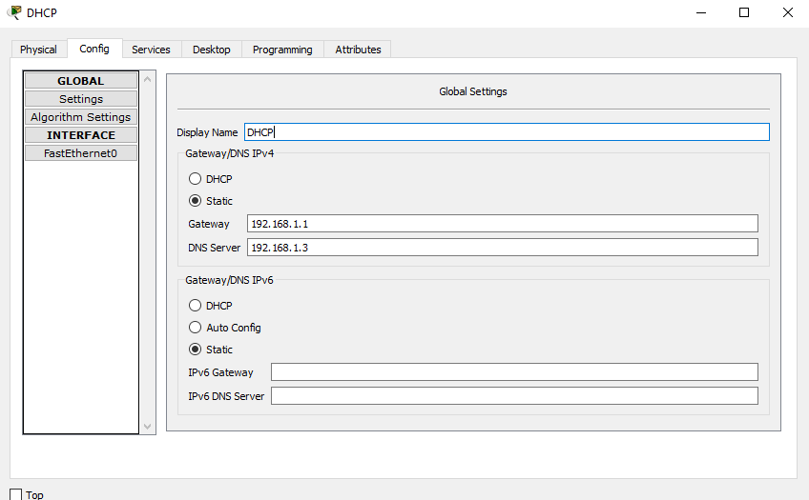
Go to first server, Rename it to DHCP

Slide 28
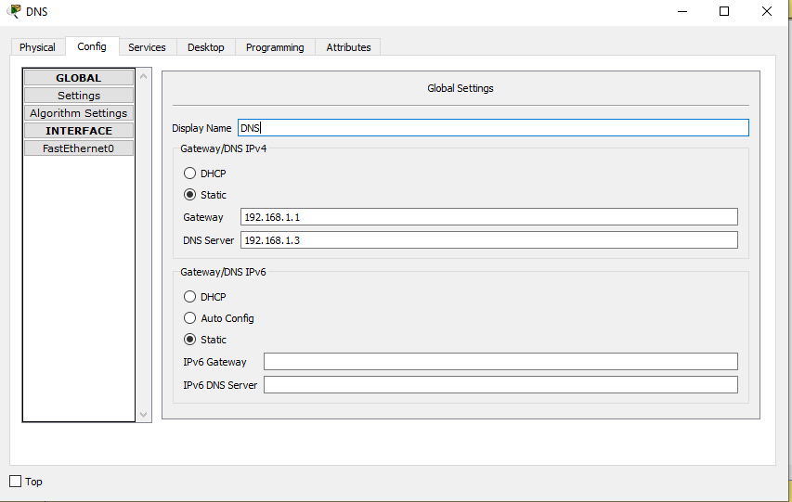
Go to first server, Rename it to DNS

Slide 29
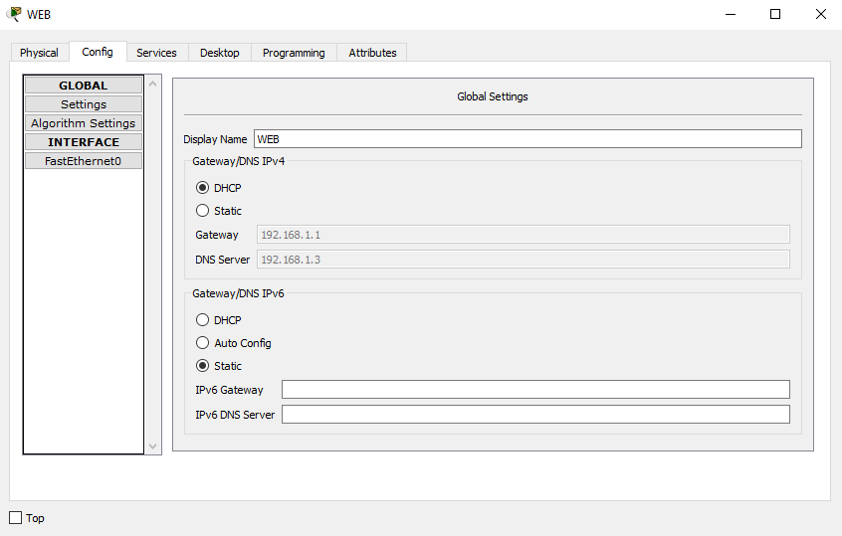
Go to first server, Rename it to WEB Server

Slide 30
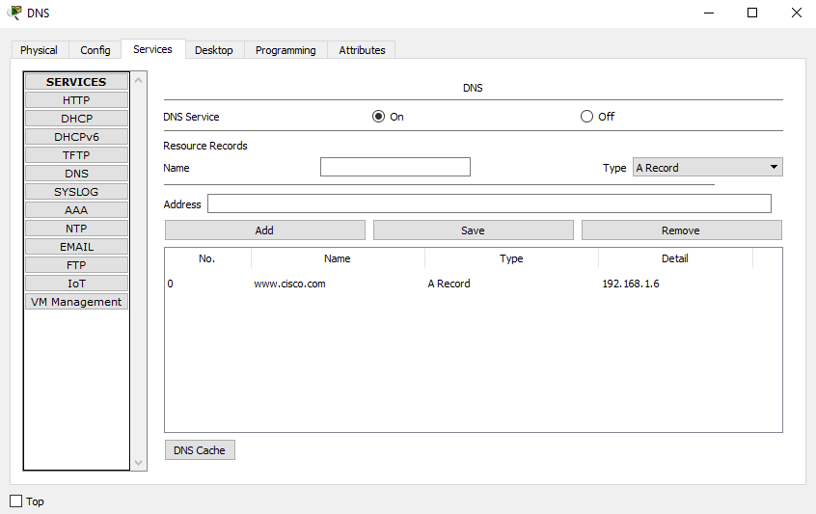
Go to DNS Server→Services→Fill up the Name and Address → Click Add

Slide 31
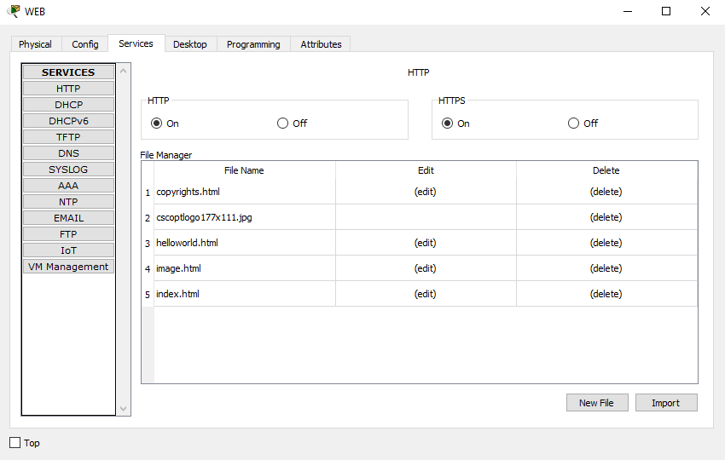
Go to Web Server→Services→ Select HTTP→Click Edit

Slide 32
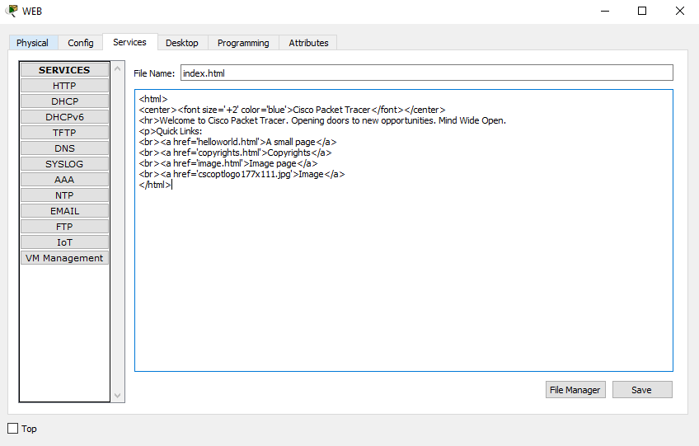
After Clicking You will get this page Now edit the web page

Slide 33
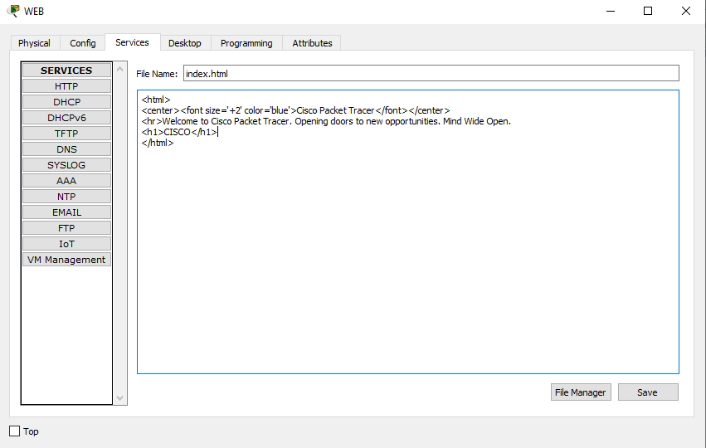
After editing the web page, click save

Slide 34
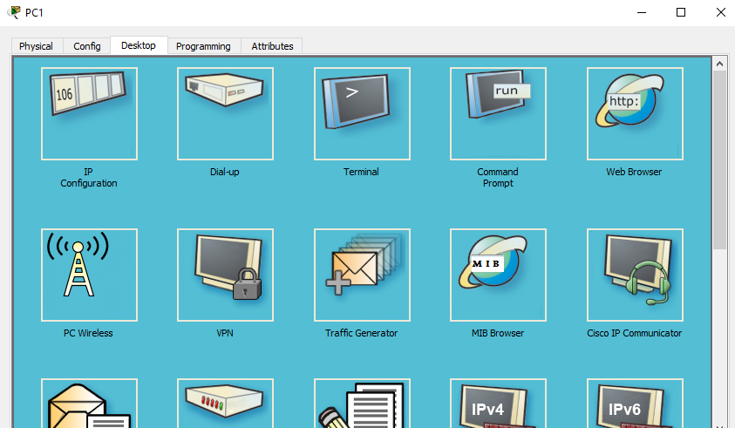
From PC1 Click the web browser

Slide 35
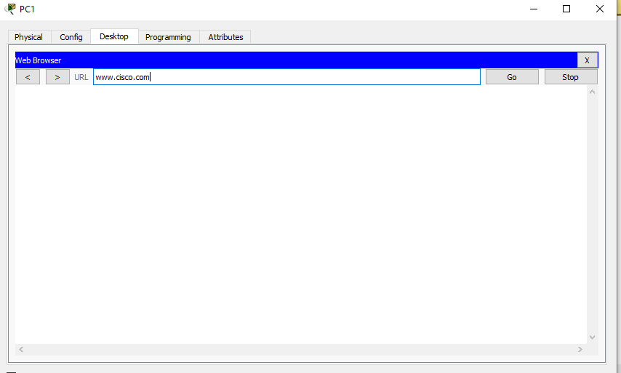
Type the IP or the corresponding Domain Name, Clock Go

Slide 36
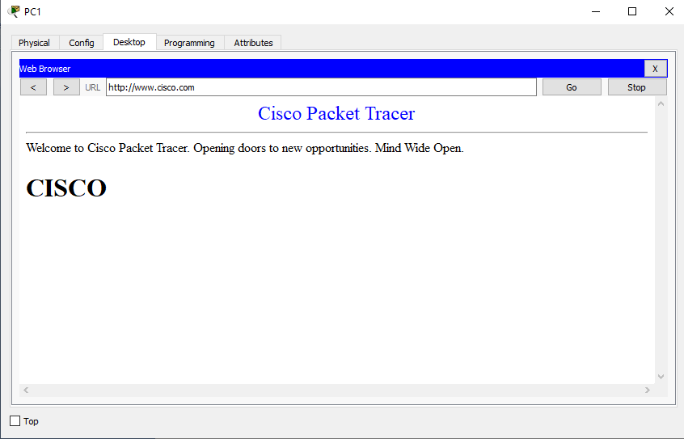
Content of the site should be visible

Slide 37
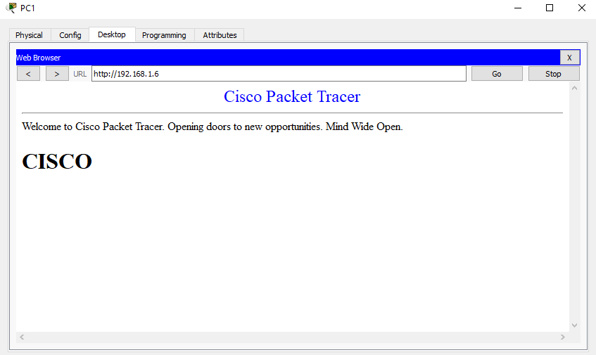
Content of the site should be visible even if the ip of the web server is given

Slide 38
Computer Network Laboratory (using Cisco Packet Tracer) Experiment-9

Slide 39
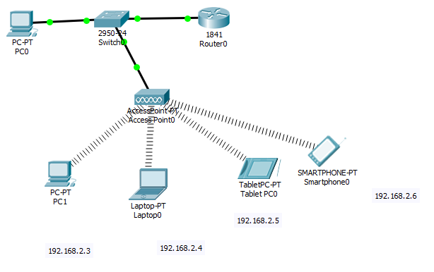
Configuration of Wireless using packet tracer
Create single network
Required components

Slide 40
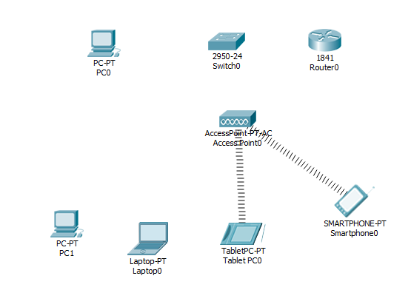
Place the devices

Slide 41
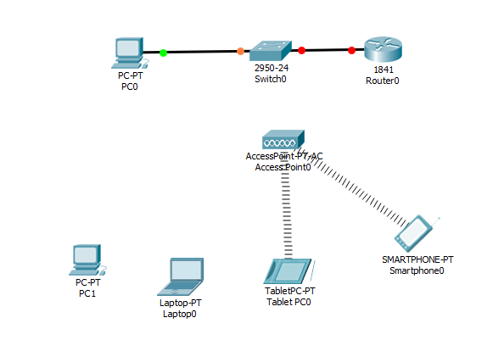
Connect the devices

Slide 42
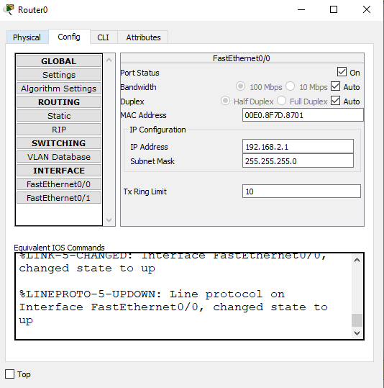
Configure the router

Slide 43
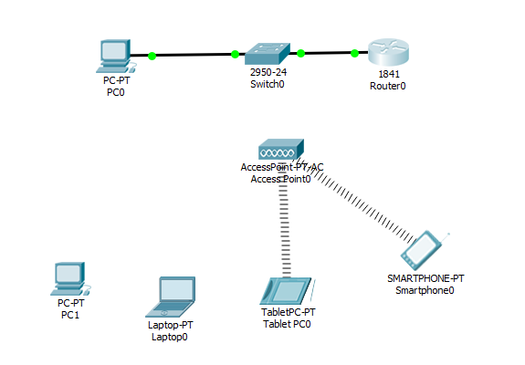
After Configuration , Links will be up, Green indication

Slide 44
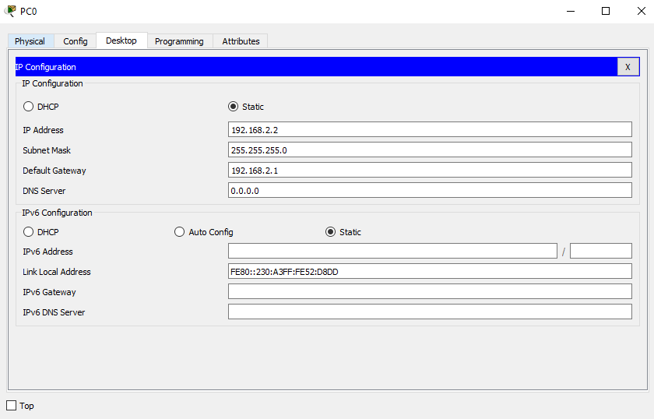
Assign IP along with default gateway address to PC0 and send one packet from pc0 to router for testing

Slide 45
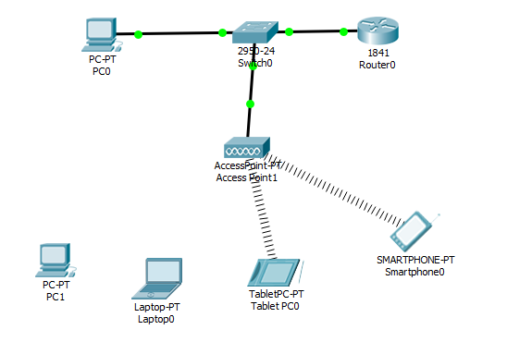
Connect Access point with switch

Slide 46
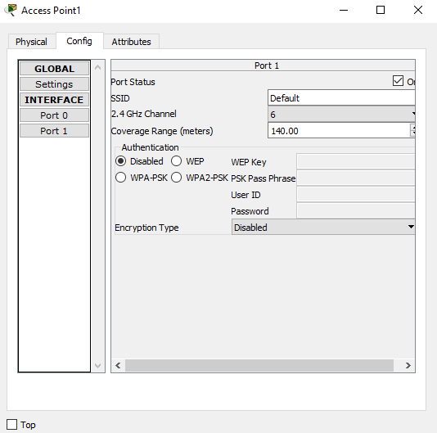
In Access Point, Go to Config , selectPort1, give SSID and Select WEP and give WEP Key

Slide 47
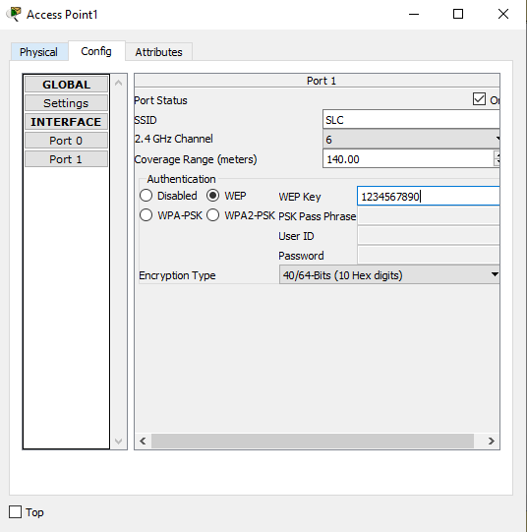
Give the required details, close the window

Slide 48
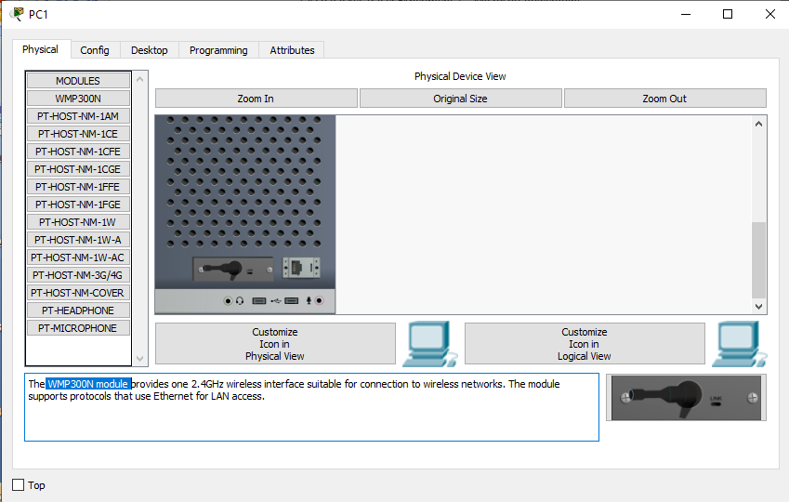
Go to PC, In Physical→Turn Off→ Remove the LAN port and place WMP300N module → Turn on the PC

Slide 49
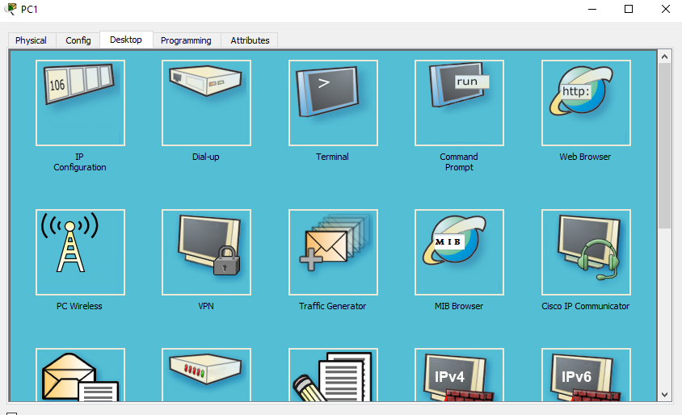

Slide 50
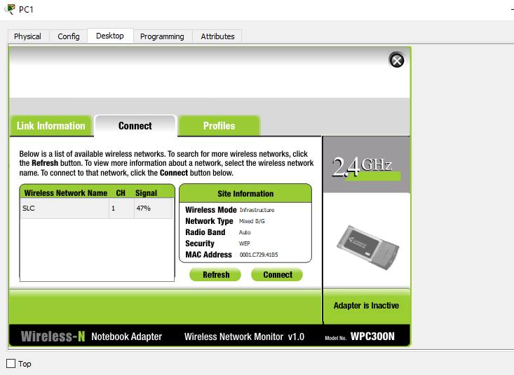
In destop→ PC Wireless , will get, Click refresh, you will get the network name, select the network and click connect

Slide 51
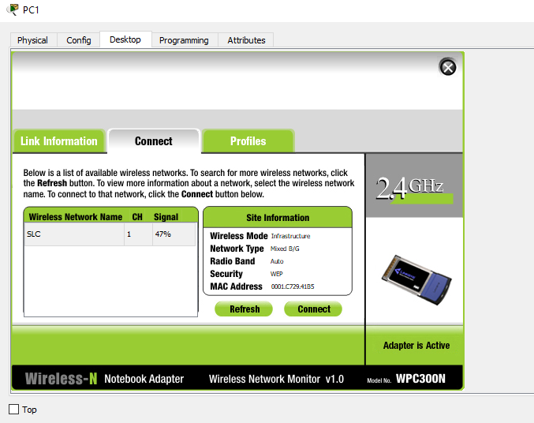
After connecting the adapter will be active

Slide 52
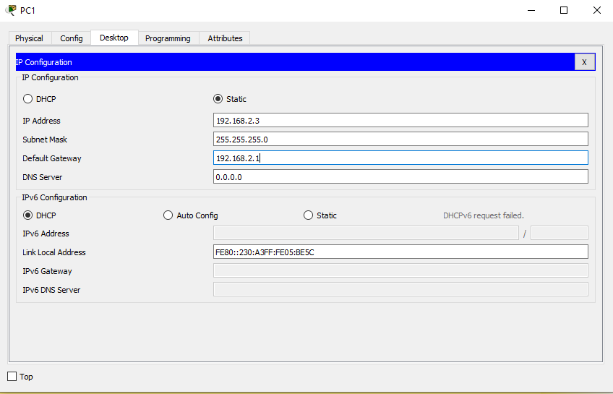
Assign IP to PC

Slide 53
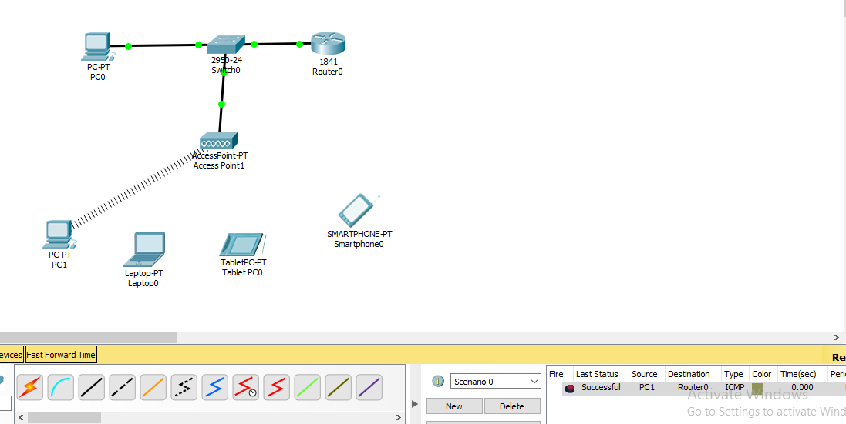
Send a packet from pc1 to router and test connectivity

Slide 54
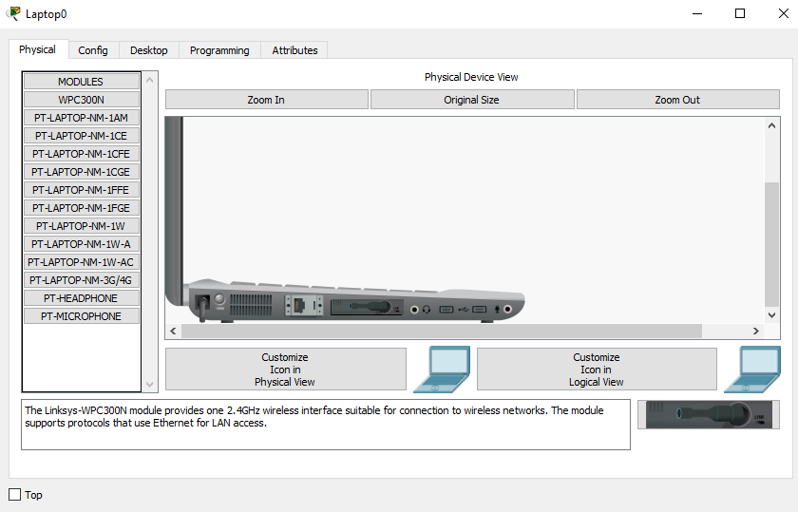
Connect laptop to Accesspoint Go to Laptop, In Physical→Turn Off→ Remove the LAN port and place WMP300N module → Turn on the Laptop

Slide 55
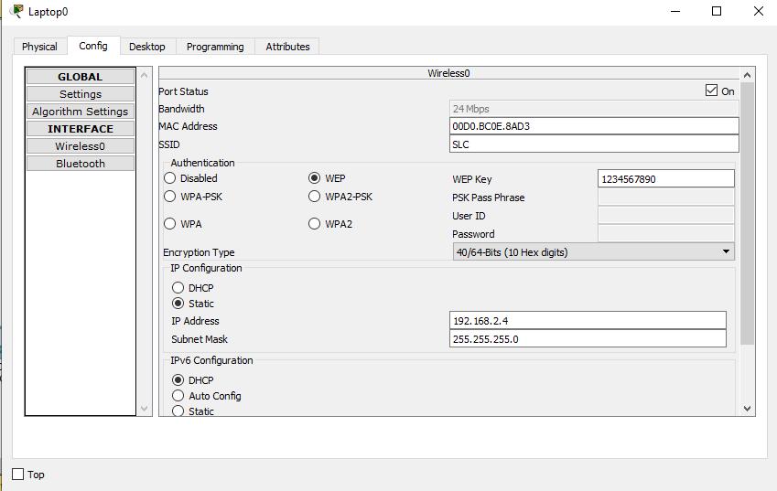
Connect laptop to Accesspoint Go to Laptop, In Config→Wireless0→ give SSID and Select WEP and give WEP Key

Slide 56
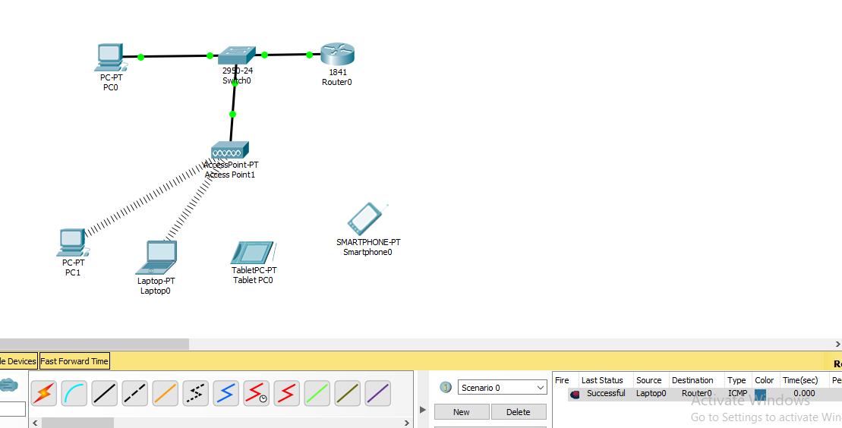
Send a packet from Laptop to router and test connectivity

Slide 57

Configure the Tablet

Slide 58

Send a packet from Tablet to router and test connectivity

Slide 59

How to connect Smartphone

Slide 60

How to connect Smartphone

Slide 61

Send a packet from Smart Phone to router and test connectivity

Slide 62

Add level to all the ip

